Slide 1
Music Feature Analysis & Multi-Label Genre Classification
JARRED MAESTAS
CS 3210

Slide 2
Why Music Genre Classification?
Practical Application in streaming apps
Technically Challenging: combining temporal and frequency pattern analysis
Personal interest in music and signal analysis
Goal: Build a deployable and somewhat accurate genre classification prediction system
DATASETS [Free Music Archive (FMA)]:
PHASE 1 (fma_small) | PHASE 2 (fma_large)
Initial Dataset (8 genres) 8,000 tracks 8 genres, balanced distribution Traditional ML baseline (Random Forest & Autoencoder) | Advanced Dataset (70 genres) 38,801 tracks 78 detailed subgenres, unbalanced distribution Multi-label: Songs have multiple genres Real-world challenge: Severe class imbalance (126x) Used for CNN
58 features 30 sec clips

Slide 3
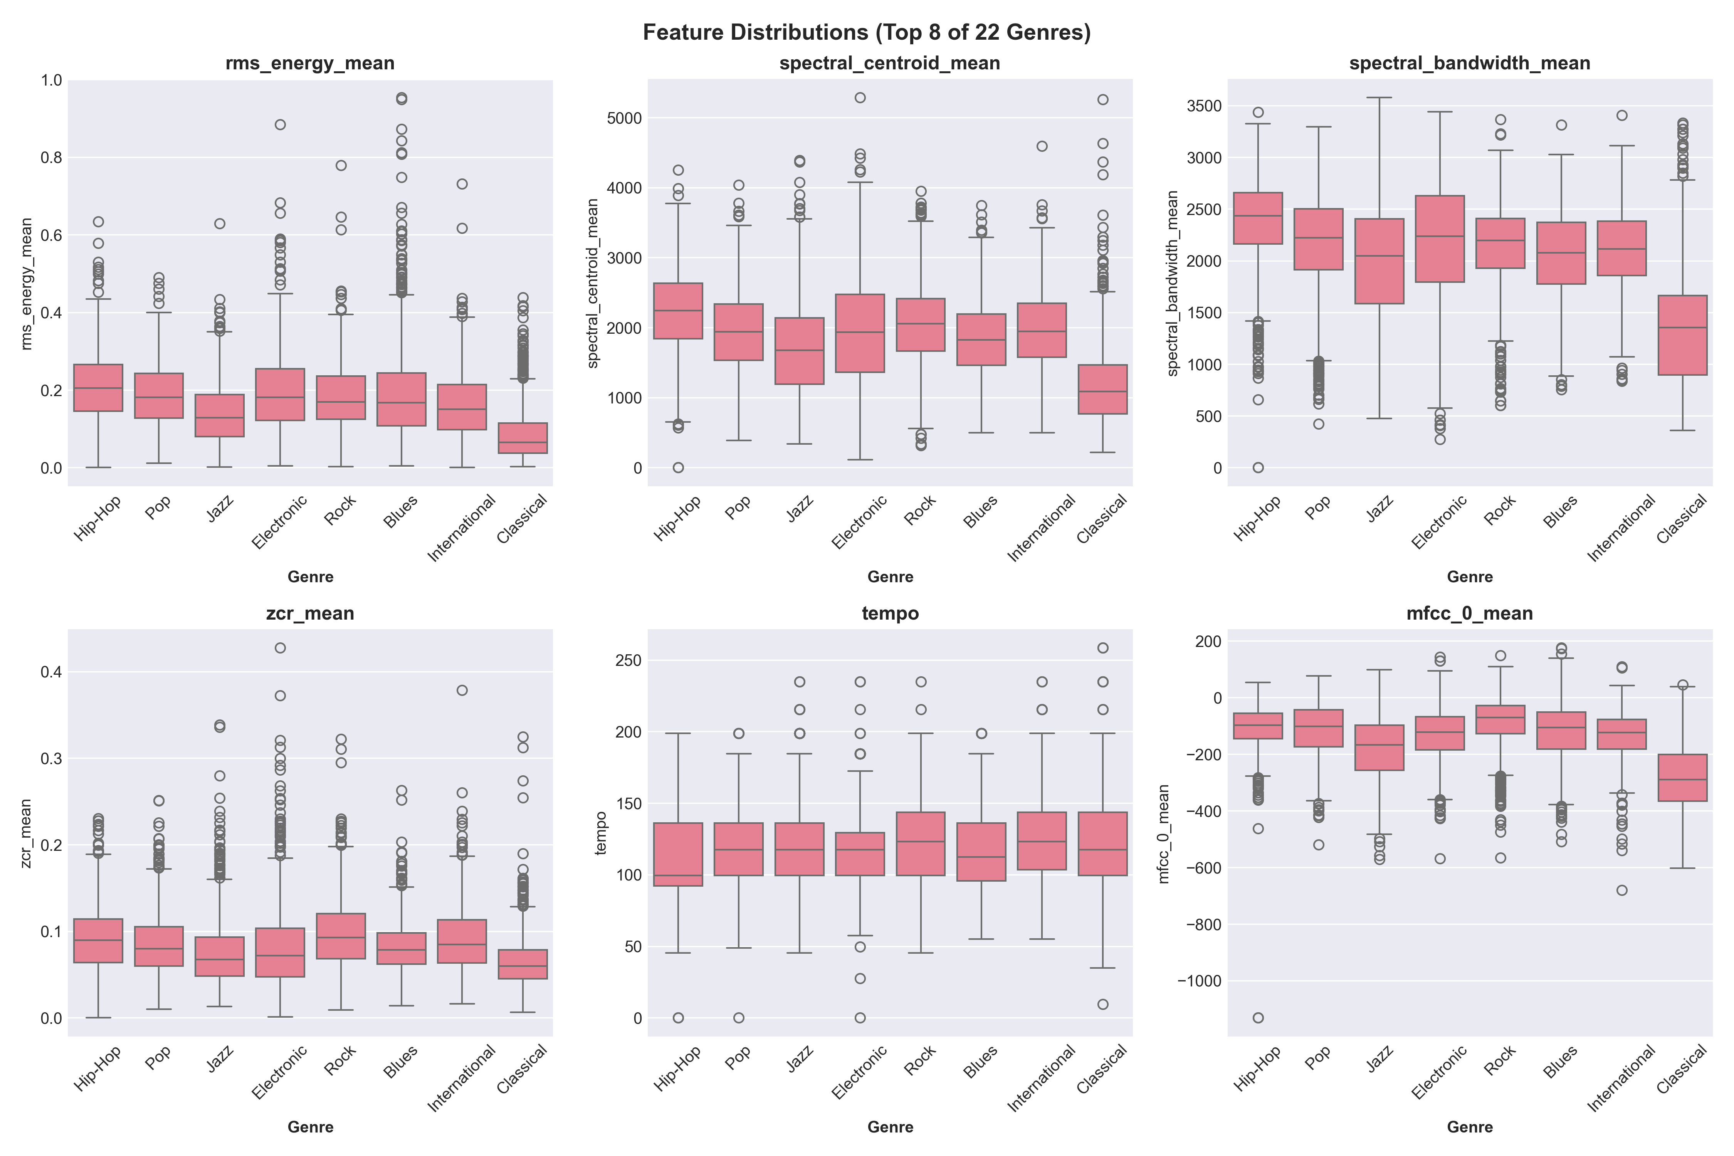
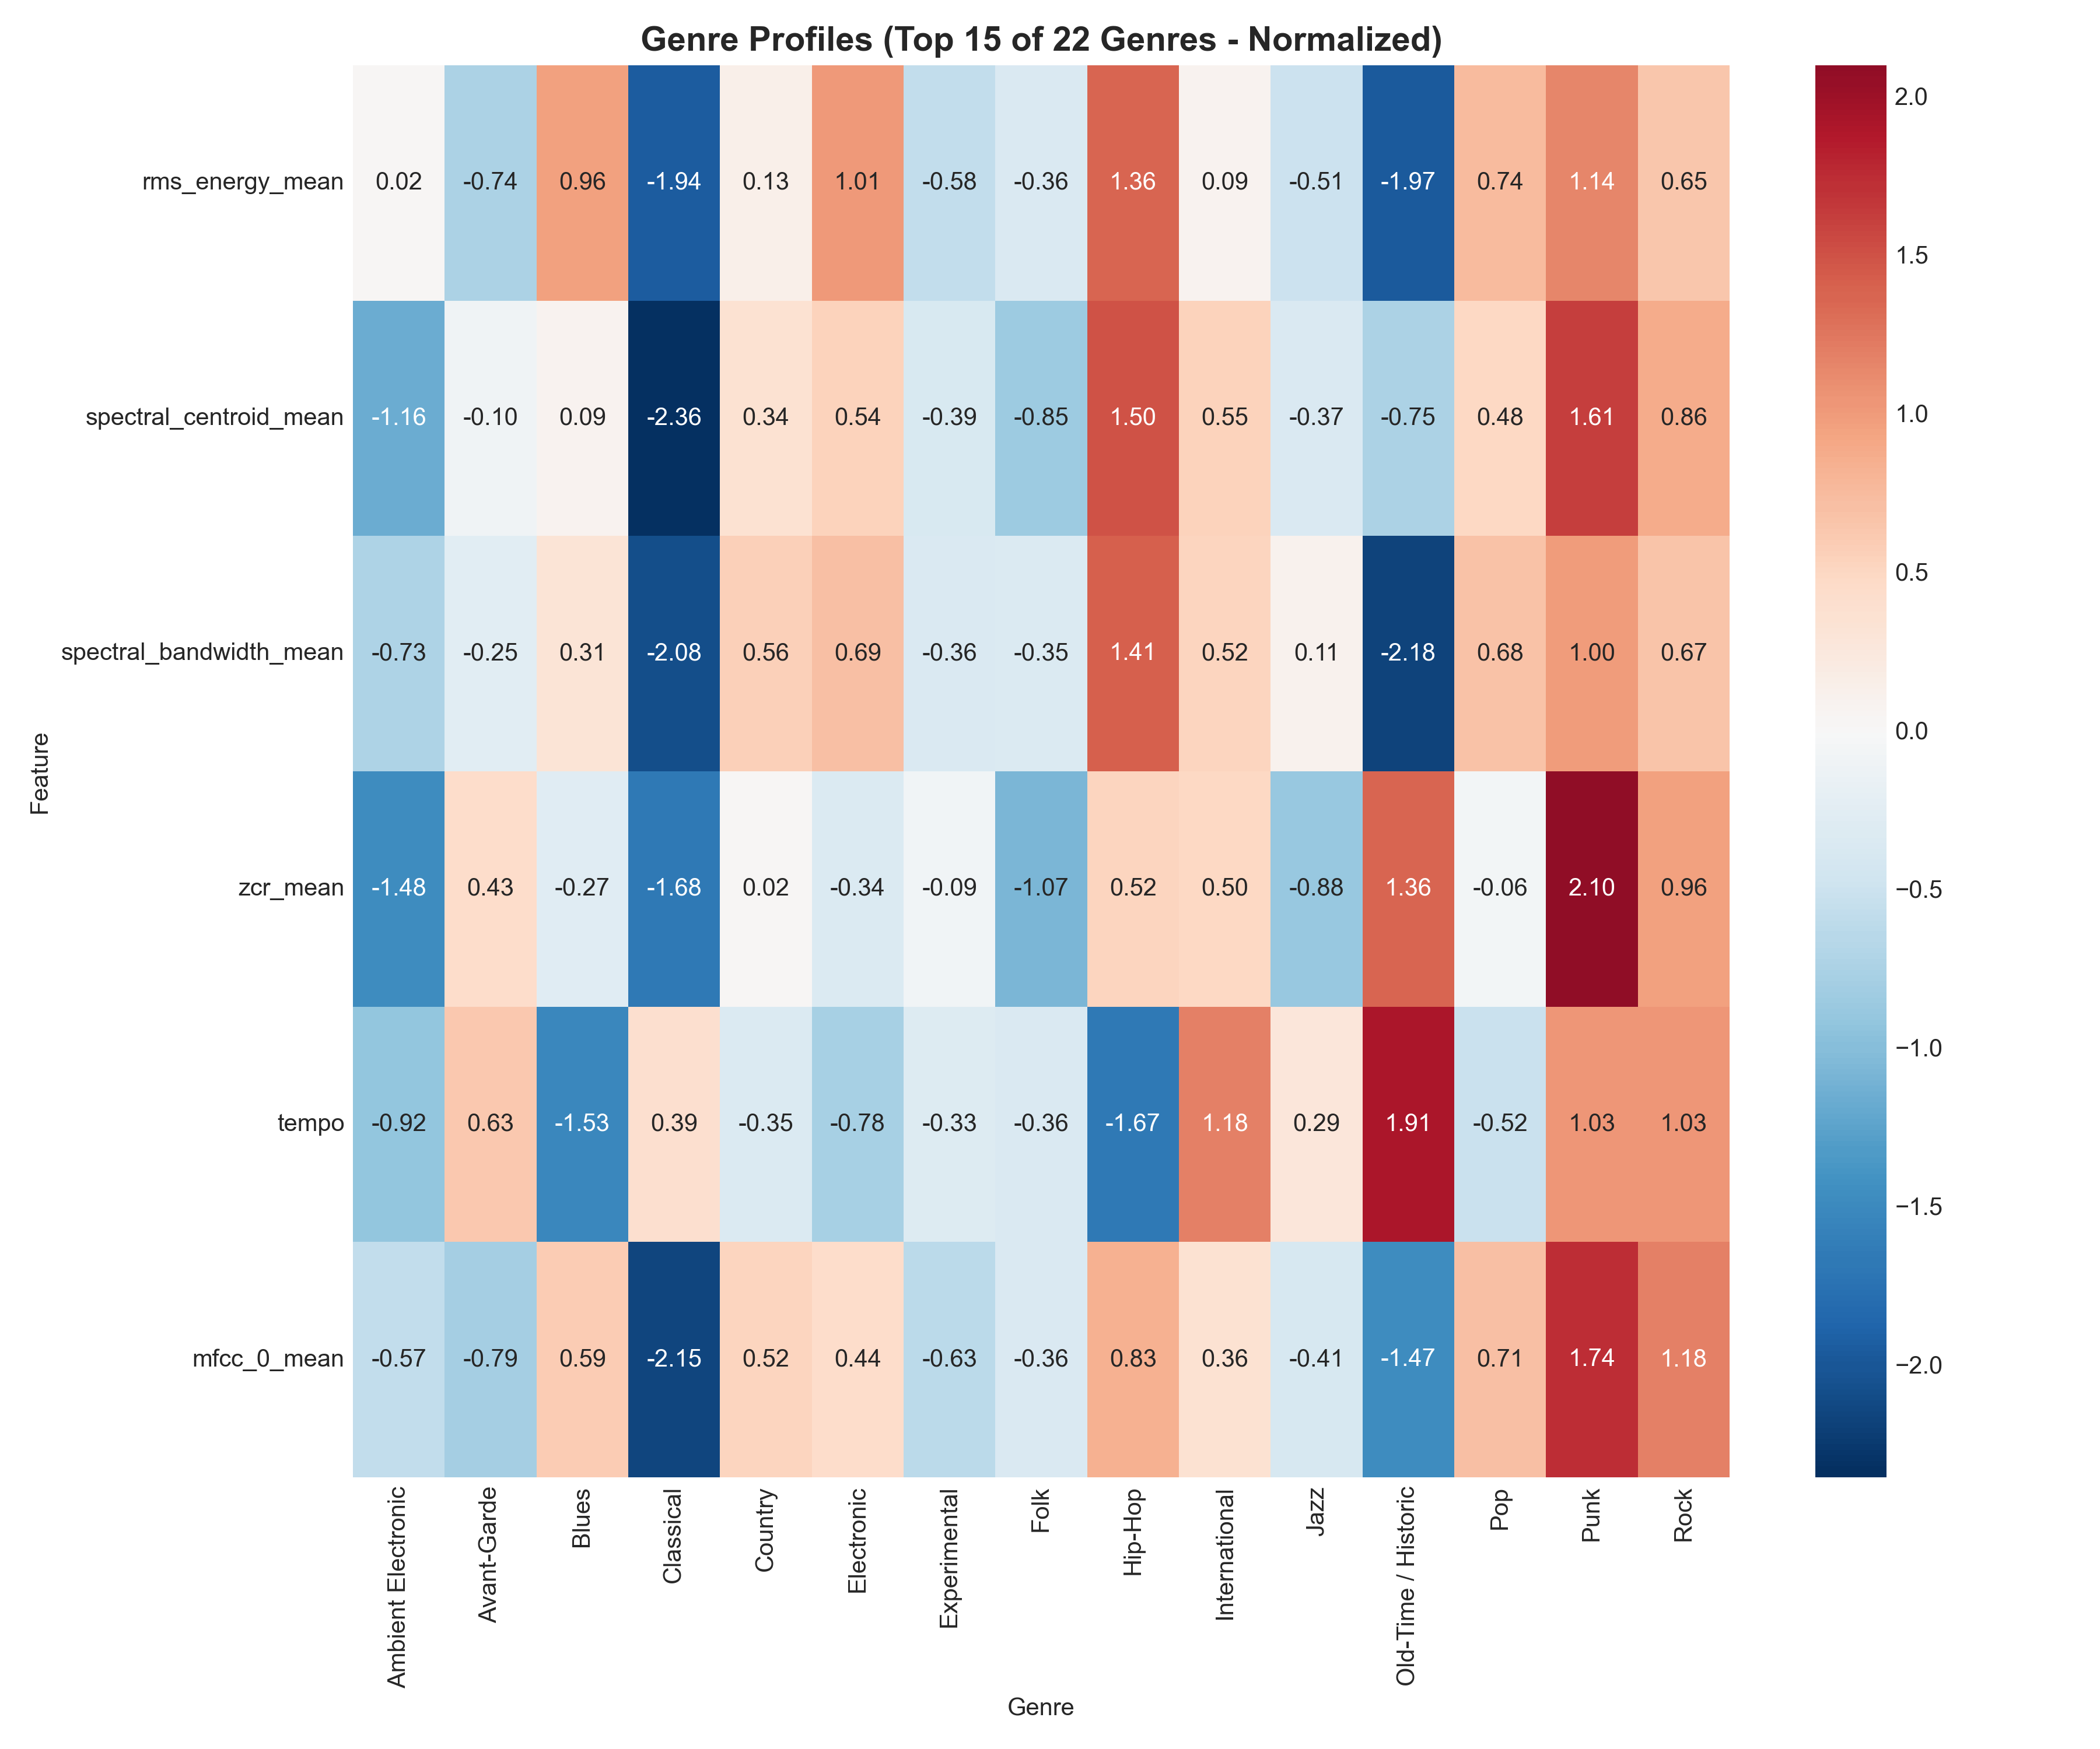
electng Visual Aids
FEATURE ANALYSIS (baseline)
Feature Extraction (done once)
Load audio file
Extract 58 features per track
Save to features.pkl
Data Cleaning
Remove missing values
Handle invalid/NaN features
Train/Val/Test Split
Categories of Features:
Temporal Features (time-based):
RMS Energy: Average loudness/volume of the song
Zero Crossing Rate (ZCR): How often the audio waveform crosses zero; indicates "noisiness" or percussiveness
Spectral Features (frequency-based):
Spectral Centroid: The "center of mass" of the spectrum; bright sounds have high centroids, dark sounds have low centroids
Spectral Bandwidth: How spread out the frequencies are; narrow for pure tones, wide for noise
Spectral Rolloff: The frequency below which 85% of the energy is contained; distinguishes clear vs noisy sounds
Rhythmic Features:
Tempo: Beats per minute (BPM)
Timbral Features:
“20” MFCCs (Mel-Frequency Cepstral Coefficients): 20 numbers that capture the "color" or "texture" of sound; think of them as describing whether something sounds "warm", "bright", "harsh", etc
Chroma: Which musical notes/pitches are present (12 values for C, C#, D, D#, ..., B)
Why Extract Features?- Allows comparison: Two songs with similar tempo, energy, and spectral centroids likely sound similar- Enables traditional ML models (Random Forest, SVM) to work with audio
Complements deep learning: CNNs learn features automatically from spectrograms, but hand-crafted features provide interpretable baselines
Feature Count: This dataset has ~50+ features per song, each capturing a different aspect of the audio.

Slide 4
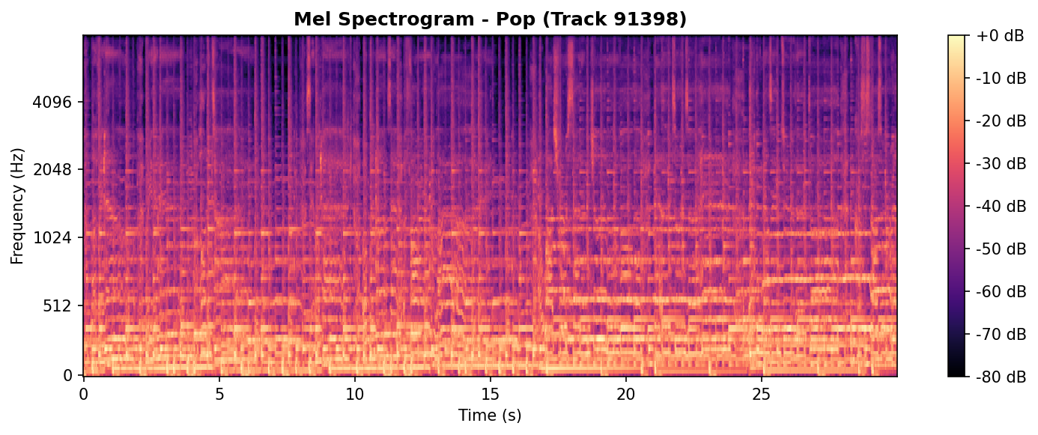
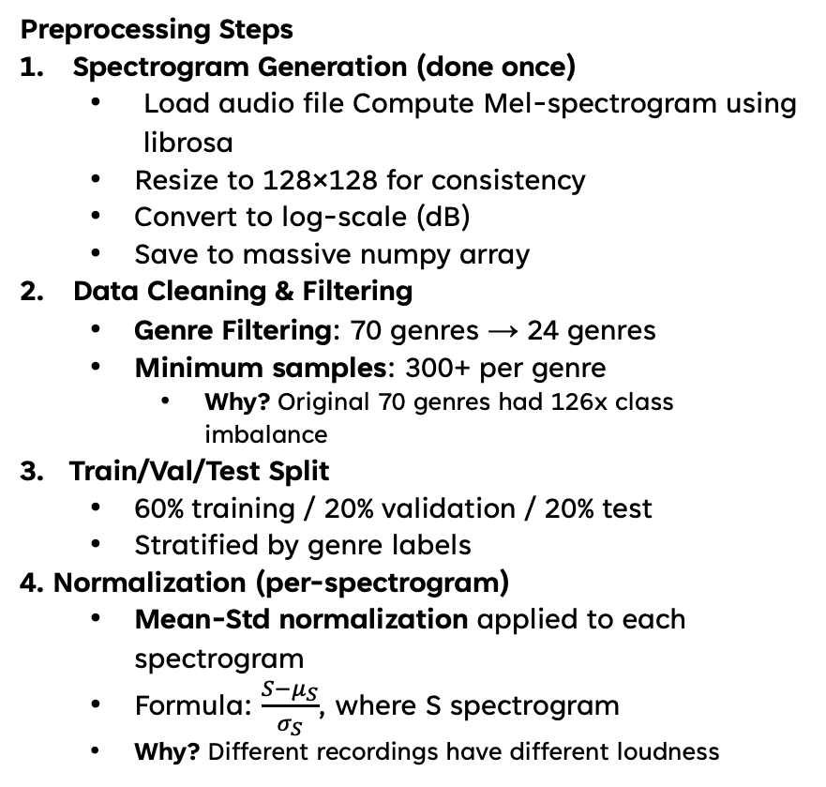
WHY CNNs for audio?
Preprocessing Steps
Spectrogram Generation (done once)
Load audio file Compute Mel-spectrogram using librosa
Resize to 128×128 for consistency
Convert to log-scale (dB)
Save to massive numpy array
Data Cleaning & Filtering
Genre Filtering: 70 genres → 24 genres
Minimum samples: 300+ per genre
Why? Original 70 genres had 126x class imbalance
3. Train/Val/Test Split
60% training / 20% validation / 20% test
Stratified by genre labels
4. Normalization (per-spectrogram)
Mean-Std normalization applied to each spectrogram
Formula: $\frac{S−μ_{S}}{σ_{S}}$, where S spectrogram
Why? Different recordings have different loudness
“Mel” Spectrograms = Images
Mel spectrograms convert audio → 128×128 matrices
Frequency (vertical) × Time (horizontal)
CNNs excel at learning spatial patterns

Slide 5
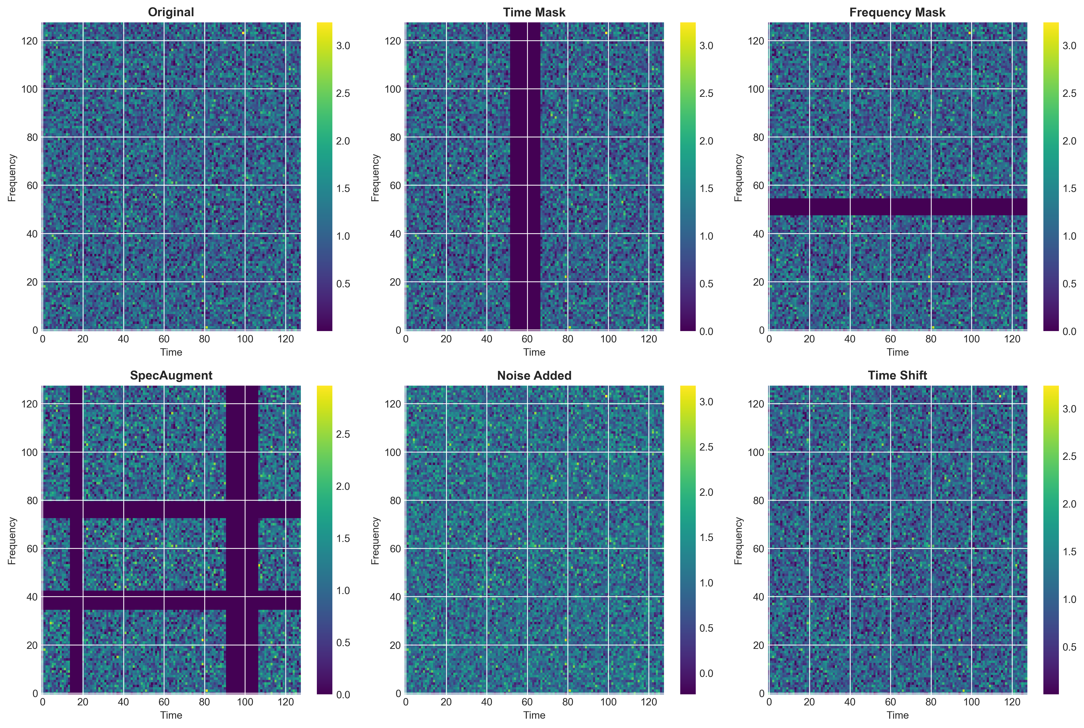
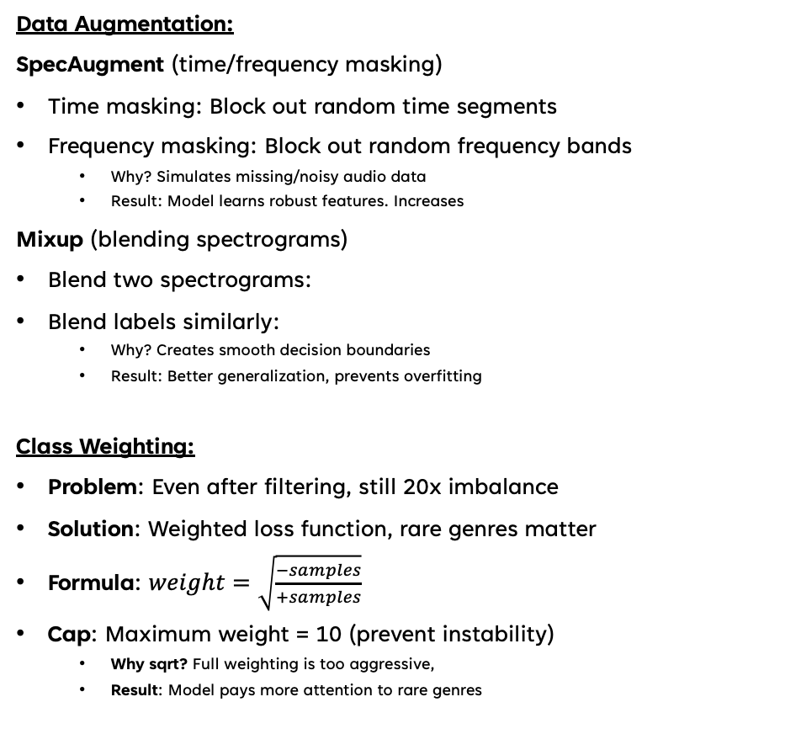
DATA AUGMENTATION & CLASS WEIGHTING
Data Augmentation:
SpecAugment (time/frequency masking)
Time masking: Block out random time segments
Frequency masking: Block out random frequency bands
Why? Simulates missing/noisy audio data
Result: Model learns robust features. Increases
Mixup (blending spectrograms)
Blend two spectrograms:
Blend labels similarly:
Why? Creates smooth decision boundaries
Result: Better generalization, prevents overfitting
Class Weighting:
Problem: Even after filtering, still 20x imbalance
Solution: Weighted loss function, rare genres matter
Formula: $weight=\sqrt{\frac{−samples}{+samples}}$
Cap: Maximum weight = 10 (prevent instability)
Why sqrt? Full weighting is too aggressive,
Result: Model pays more attention to rare genres
Happens during data/class loading for training
CNN learns features automatically
No Data Loss compared to predefined features
Combined resulted in 4.5x imbalance!
DA Increases training data 3-5x

Slide 6
Multi-label CNN
Single Label CNN | Advanced Multi-Label CNN
Track has one genre 4 conv blocks 32→64→128→256 3.2M parameters (8 genres) Single-label (softmax) | Tracks have multiple genres 20+ layers ResNet-style Channel attention (4 modules) 3.6M parameters (70 genres) Multi-label (sigmoid per genre)
Resnet: Skip connections enable deep networks (20+ layers) Solves vanishing gradient problem Better gradient flow during training Attention: Learns importance of different frequency bands Efficient scaling: Adding genres barely increases model size

Slide 7
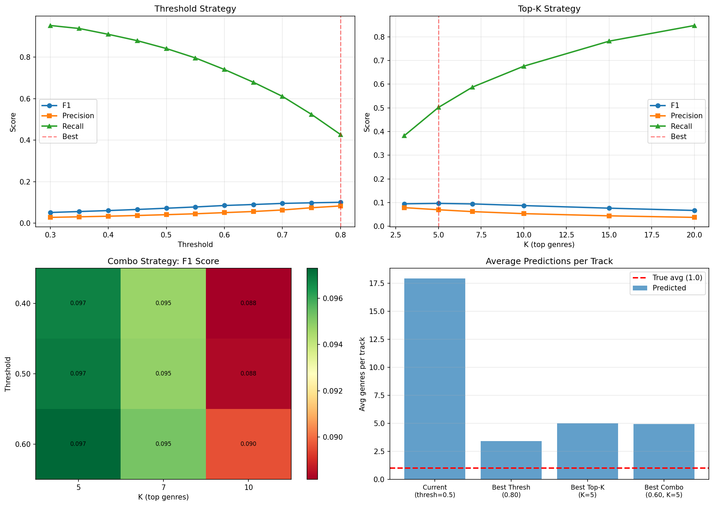
results
Model: 70 genres, 38,801 samples | Model: 24 genres, 32,856 samples
Metric Value _ F1 Score 13.4% Precision 7.8% Recall 77.0% Avg Predictions 15-20 genres/track * Model predicts too many genres | Metric Value _ F1 Score 35.2% Precision 32.7% Recall 64.5% Avg Predictions 2-3 genres/track
Threshold tuning
Strategy F1 Precision Recall Original (0.5) 13.4% 7.8% 77.0% Best Threshold (0.8) 10.1% 8.3% 42.7% Best Top-K (5) 9.7% 7.0% 50.2% Best Combined 9.7% 7.1% 50.1%
* Threshold tuning cannot fix fundamental problems

Slide 8
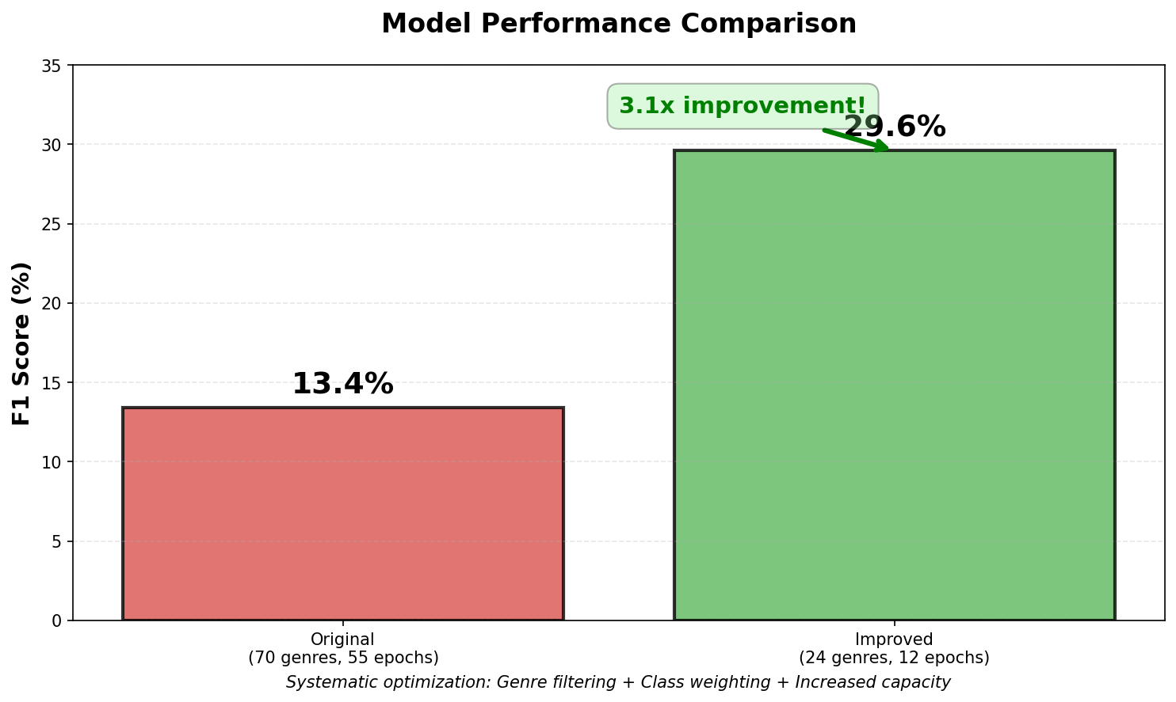
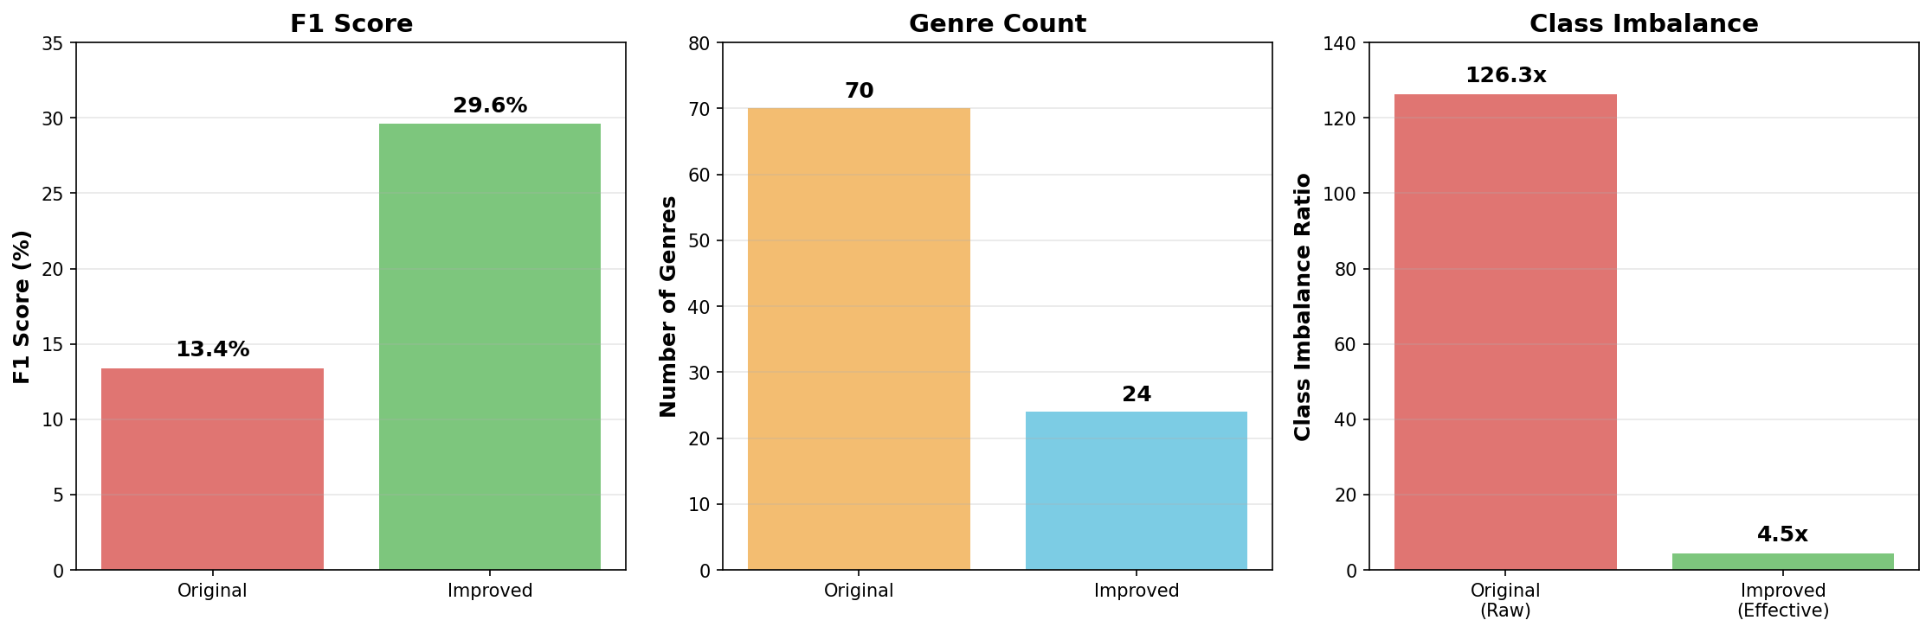
COMPARISON

Slide 9
TAKEAWAYS/LESSONS LEARNED
Data Quality > Model Complexity
126x class imbalance broke the model
Filtering to well-represented genres had bigger impact
Threshold Tuning Has Limits
Cannot fix a poorly-trained model
Must address root causes (data quality, class imbalance)
Multi-Label is Hard
Real-world complexity (songs have multiple genres)
Precision-recall tradeoff is challenging
Need careful calibration
LONG-TERM IMPROVEMENTS
Temporal models: RNNs/Transformers for longer context
Transfer learning: Pre-trained audio models (Wav2Vec2)
Hierarchical classification: Genre taxonomy (Rock → Metal→ Death Metal)
Active learning: Focus on hard examples

Slide 10
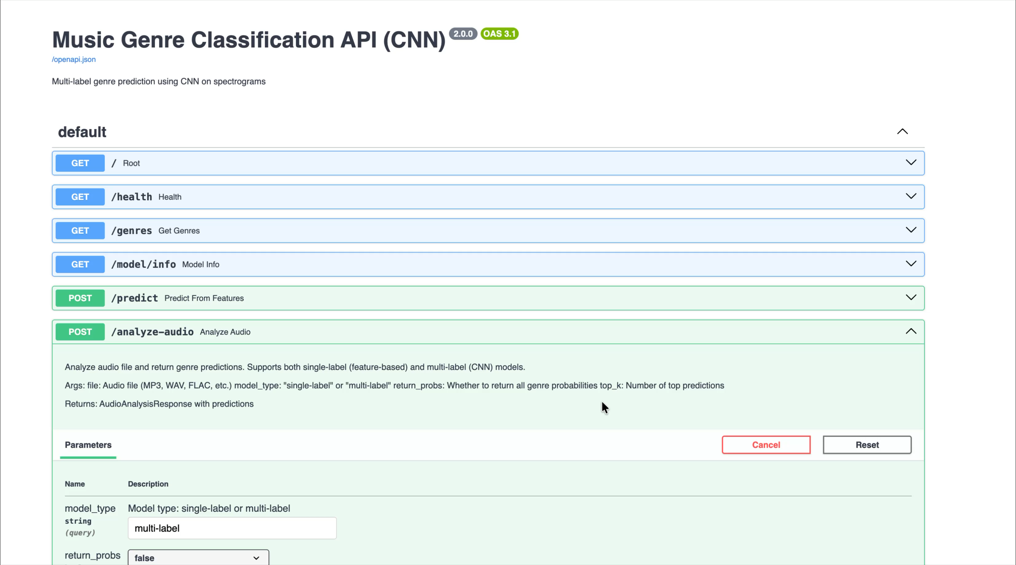
DEMO

Slide 11
THANK YOU

